Slide 1
From Rumors to Facts: Evaluating Football Transfer News
Yang Hongyi, Chen Ziyi, Wen Shenghan
2024.12.18

Slide 2
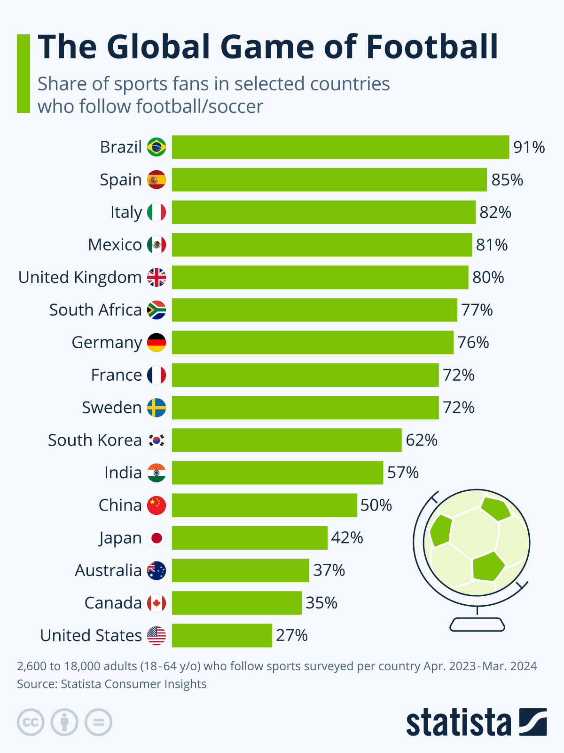
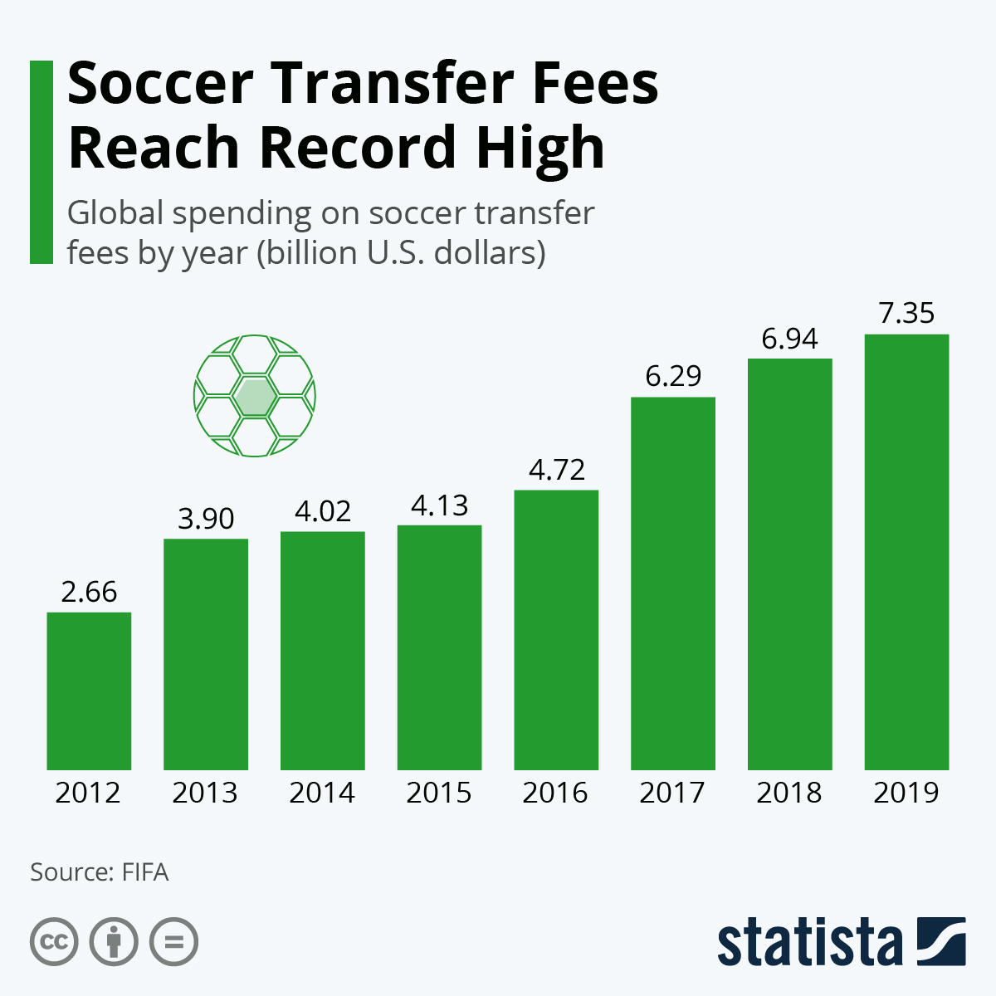

Introduction
The game of the world…
So is the market…
Along which comes NEWS/RUMORS!
Figures:

Slide 3
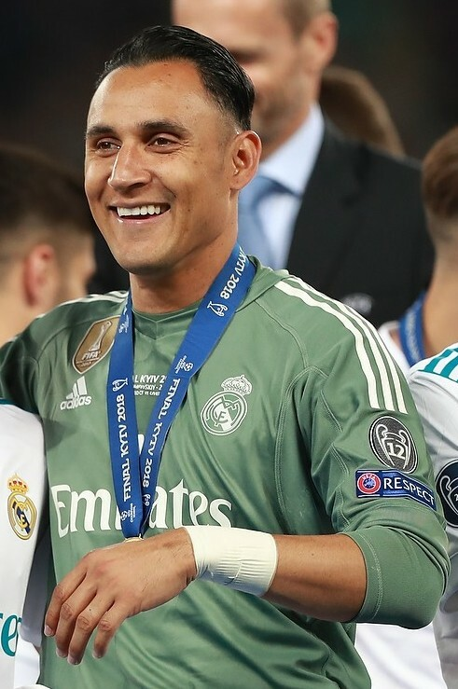
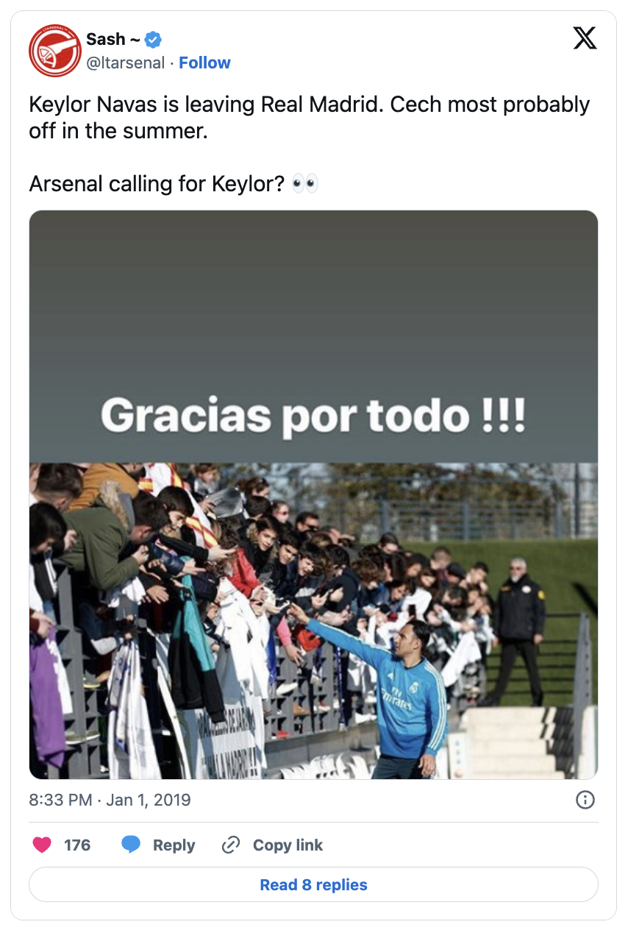

Introduction
How it may go…
Navas signed a new one-year deal to stay at Real Madrid.
In the end…
The Sun and The Mirror jumped the gun reporting on Arsenal making a
£14 million bid for the player.
Arsenal manager, Unai Emery later dismissed the report
as “not true”.
Keylor Navas
Start with…
Then…
Source: https://medium.com/@ConnorBean6/the-fake-online-news-of-football-transfers

Slide 4
Introduction
How it may go…
Navas signed a new one-year deal to stay at Real Madrid.
In the end…
Our questions:
Can transfer rumor sources be classified based on their characteristics?
How much factual basis do these rumors contain regarding footballer transfers?
The Sun and The Mirror jumped the gun reporting on Arsenal making a
£14 million bid for the player.
Arsenal manager, Unai Emery later dismissed the report
as “not true”.
Keylor Navas
Start with…
Then…
Source: https://medium.com/@ConnorBean6/the-fake-online-news-of-football-transfers

Slide 5
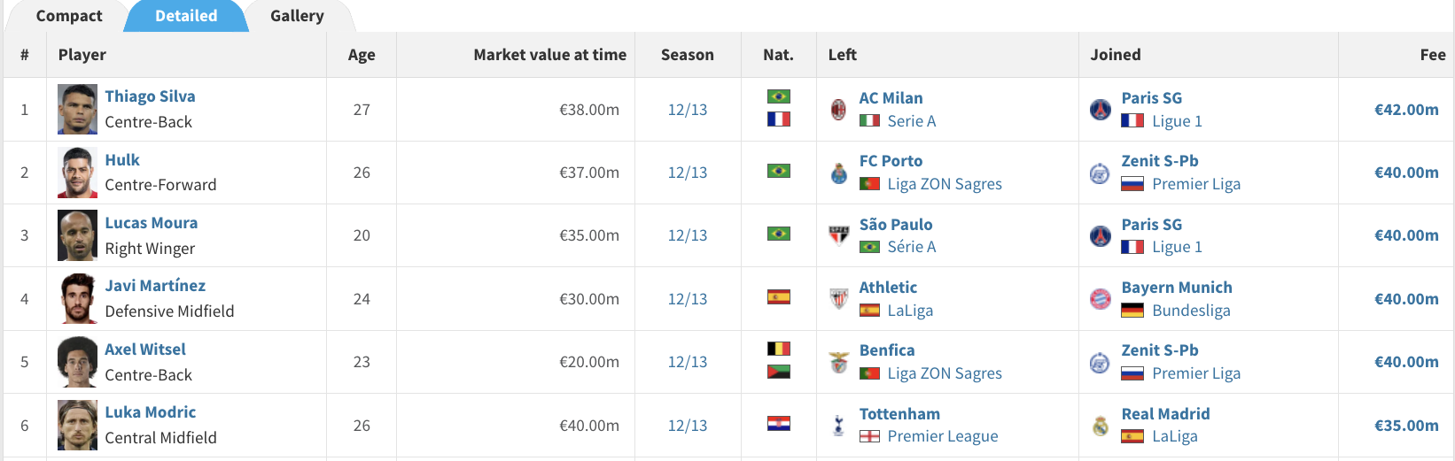
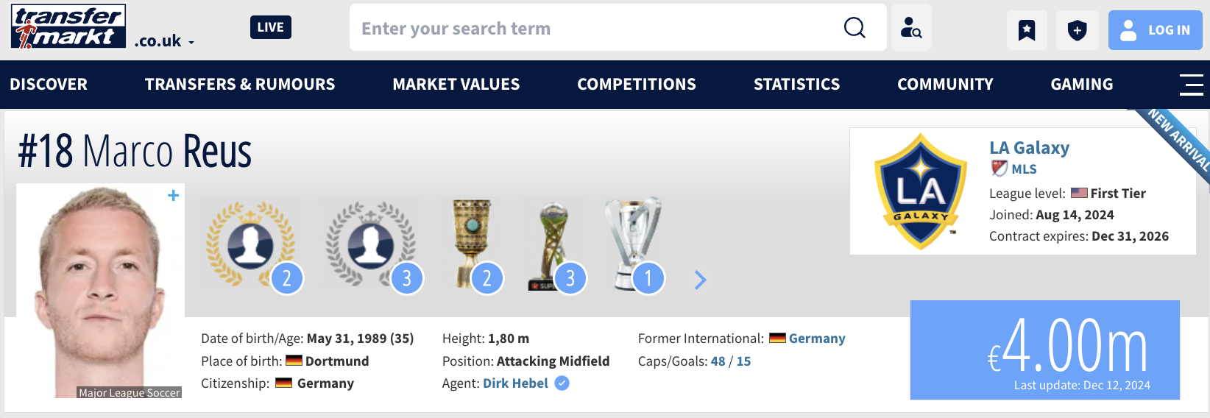
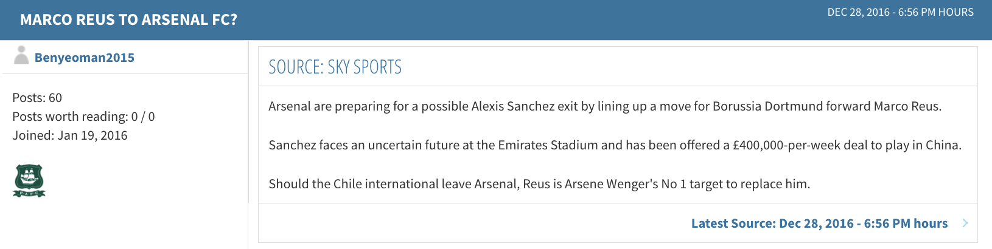
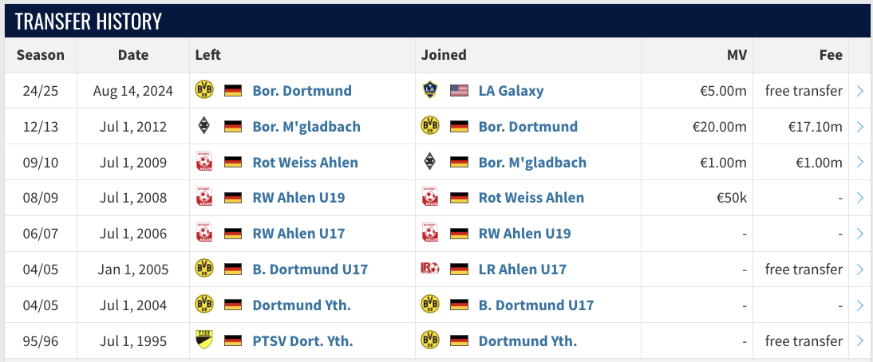
Data Acquisition
transfer records (2005-2023)
Rcrawler
player pages
Dataset: www.transfermarkt.co.uk
rvest
Rcrawler
jsonlite
associated rumors
rvest
player transfer history

Slide 6
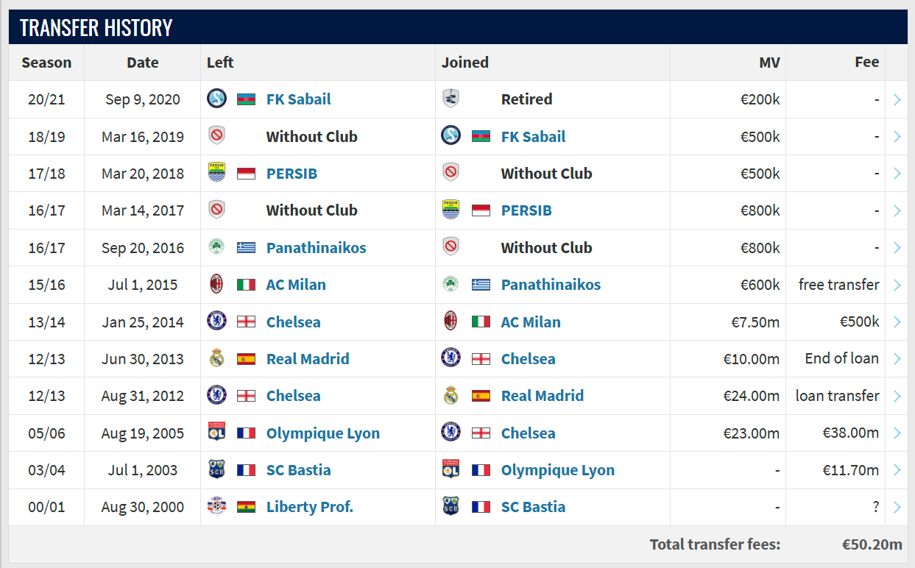
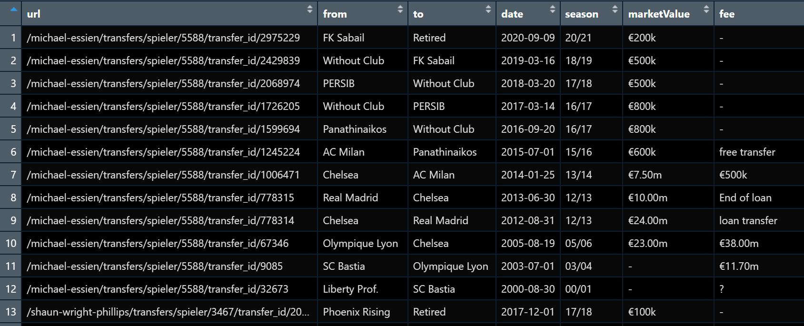
Data Acquisition
Facts
38389 Transfers as Ground Truth

Slide 7
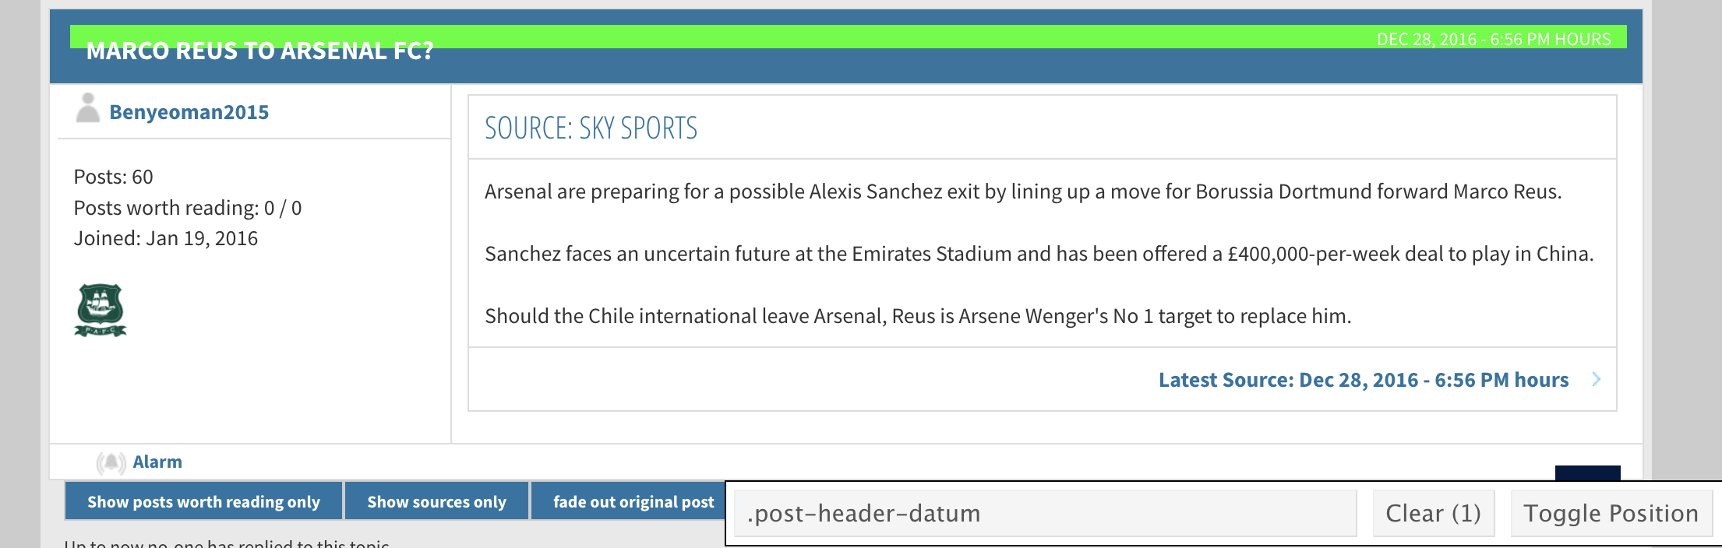
Data Acquisition
Rumors
Rumor.Source
Rumor.Content
Rumor.Date

Slide 8

Data Acquisition
associated rumors
Syuzhet package
Words matched against a sentiment lexicon
Scores summed up
GPT-3.5 turbo
"Given the transfer news text, analyze and evaluate the likelihood of PLAYER transferring to CLUB.
Provide your response in JSON format with the following keys: {
'language': (e.g., 'english', 'german', 'scots', etc.),
'confidence': -1, -0.5, 0, 0.5, 1 (where -1 means 'very unlikely’,
-0.5 'unlikely', 0 'neutral', 0.5 'possible', 1 'very possible’),
'reason': A brief explanation of the confidence score.
}. Respond strictly in JSON format. No additional text.
News content: … "

Slide 9

Data Alignment
A. Source URL alignment
"Source: Guardian"
"Source: L´Equipe"
"www1.bbc.com"
"https://www.theguardian.com"
"https://www.lequipe.fr"
"https://www.bbc.com"
First Organic Search Result || Rectify
B. Rumor - Fact alignment
Fact
Rumor
Star.Name (Recitified)
Rumor.Date
EQUAL
Star.Name (Recitified)
Fact.Date
No Earlier than & Temporal Proximity
To.Club (Recitified)
T / F
To.Club (Recitified)

Slide 10
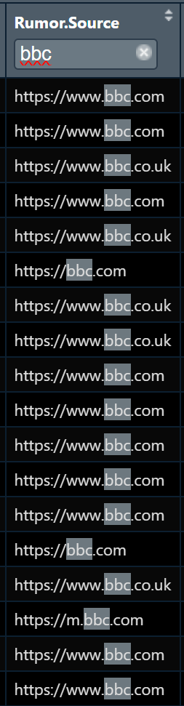
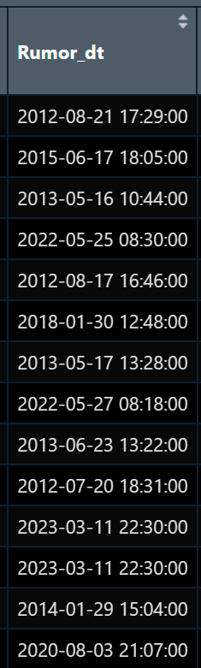
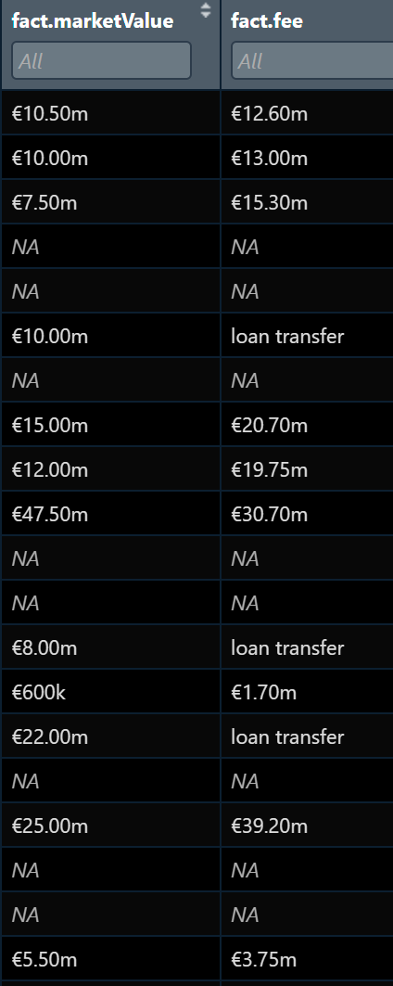
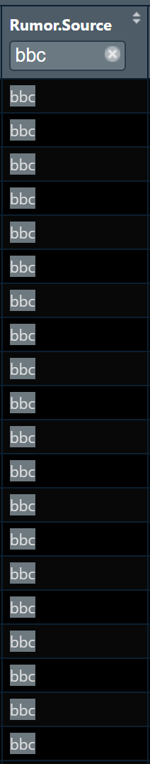
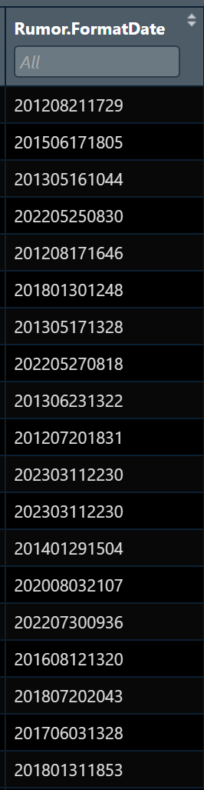
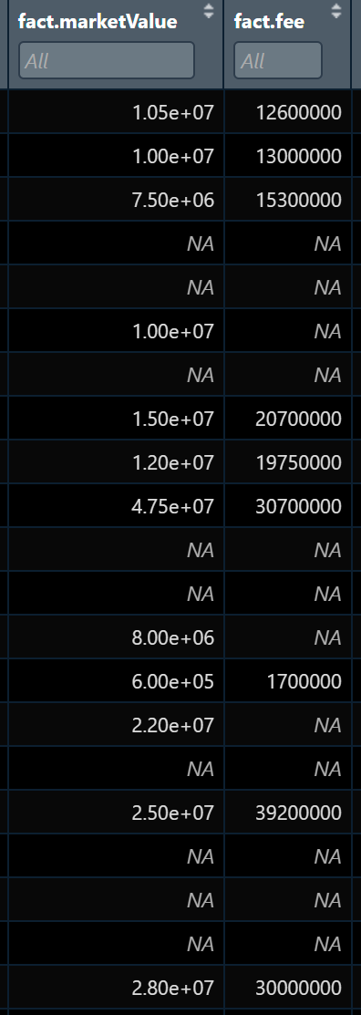
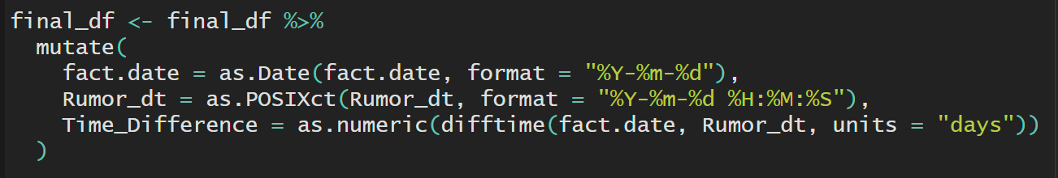
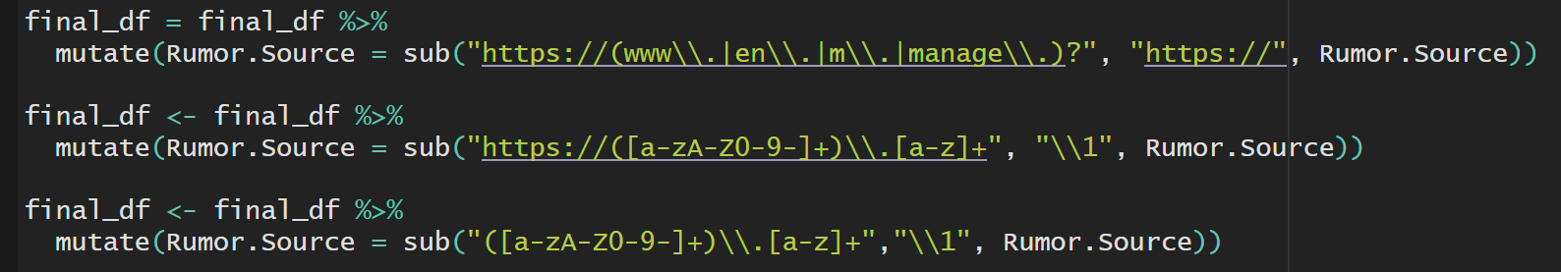
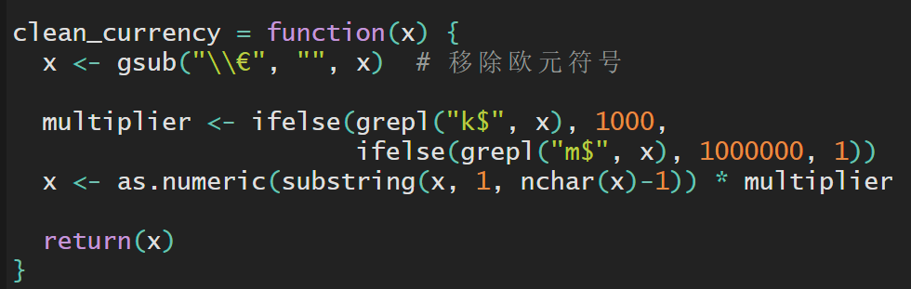
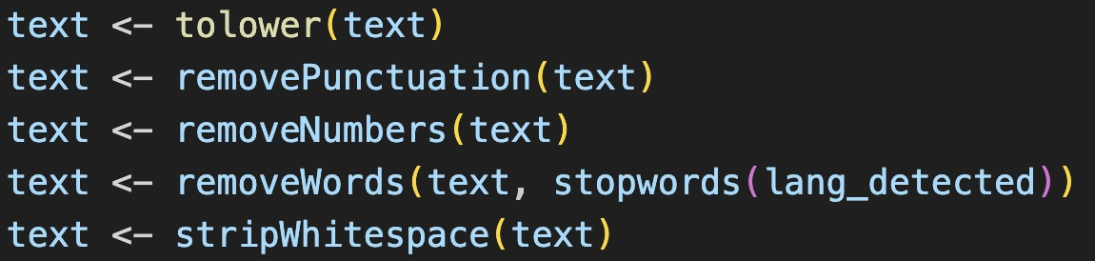
Data Cleaning and Preprocessing
Regex expression
Formatted Time
Formatted value
A total of 13251 rumors processed
Match url start (https://) and delete subdomain name (www./en./m.)
Match and delete top domain name (.co/.uk/.co.uk … etc)

Slide 11
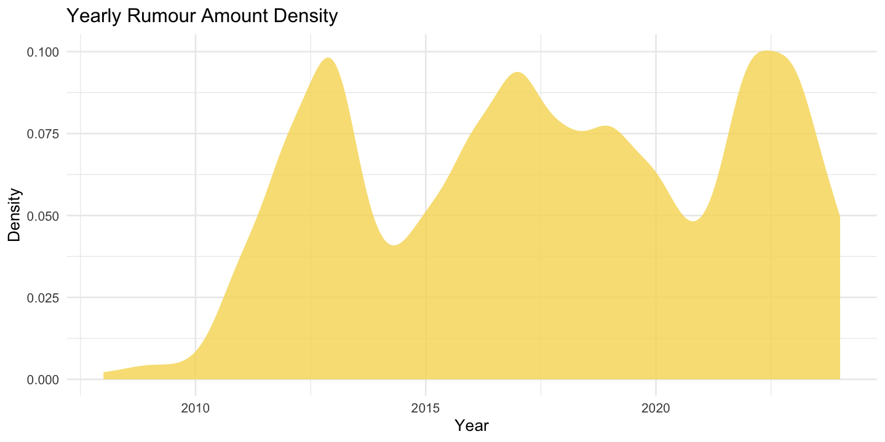
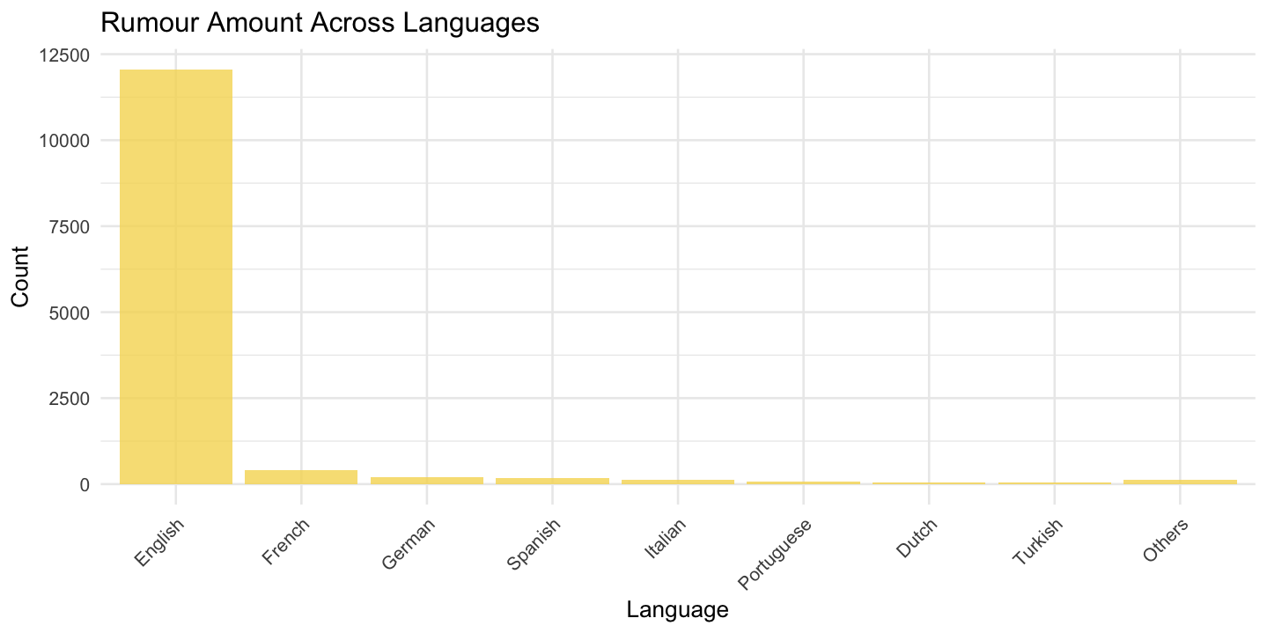
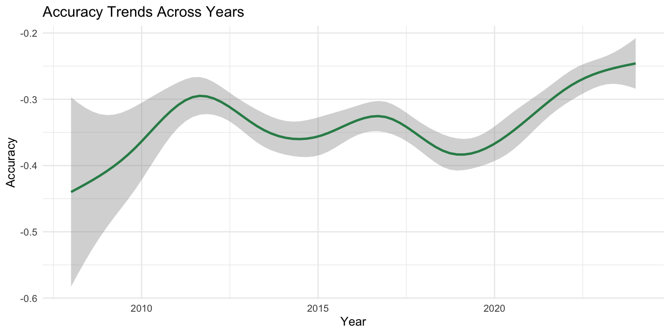
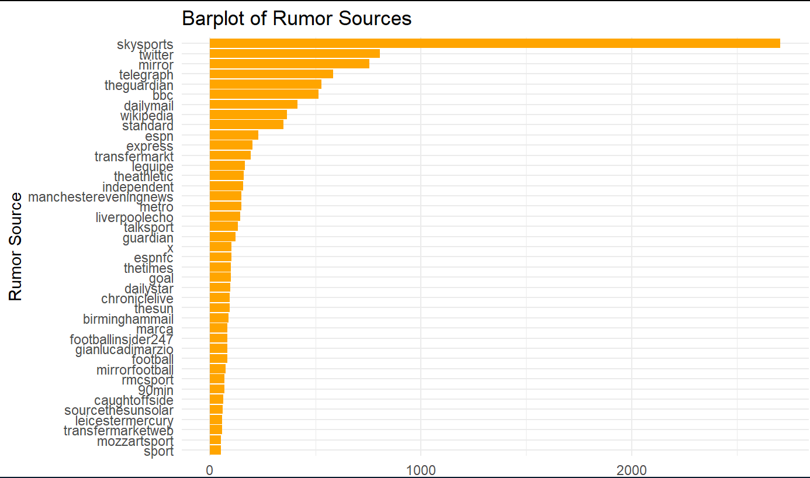
Data Acquisition
13251 rumors fetched, T:F=2036:11215

Slide 12
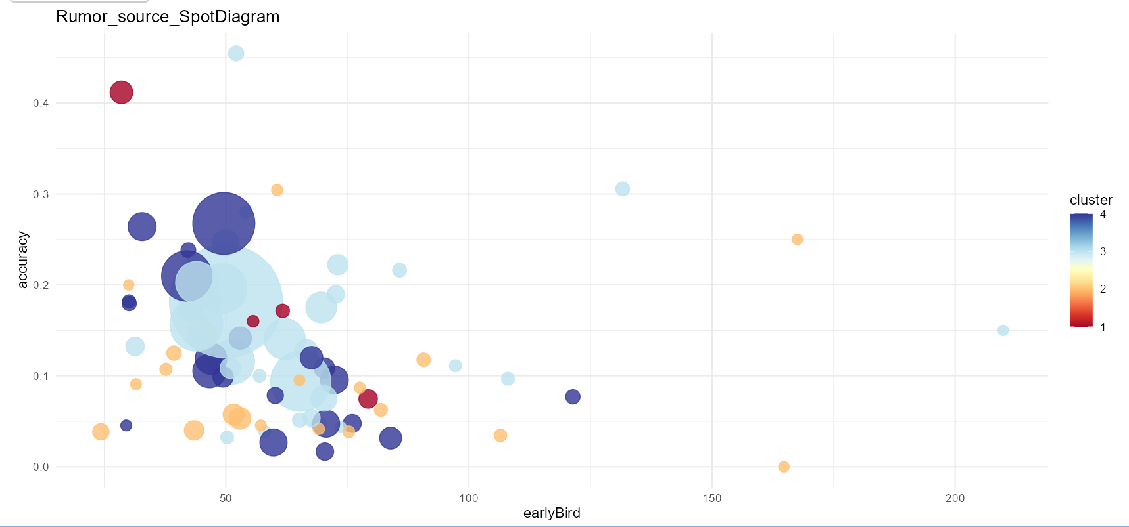













Source-specific Characteristics
Kmeans, n=4
X: Time difference between rumor and actual transfer
Y: Accuracy
Notes:
以accuracy作为y轴，earlyBird为x轴作图

Slide 13
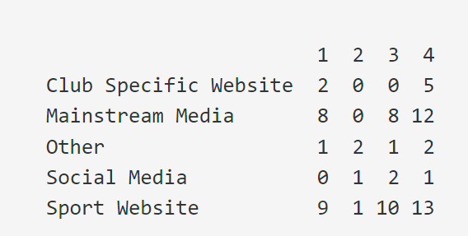
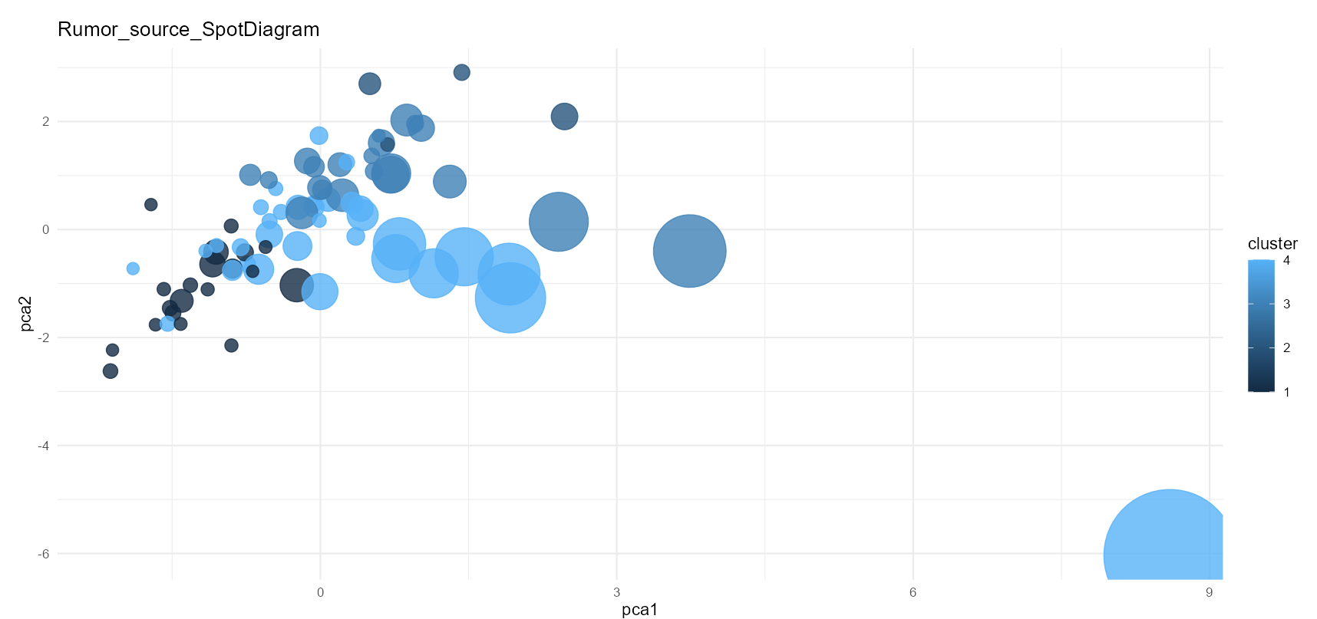
Source-specific Characteristics
Notes:
PCA主成分分析后，可以观察到较好分离的各组source
Kmeans的分组结果和实际的网站性质也有一定关联（不同source type对cluster的倾向也不同）

Slide 14
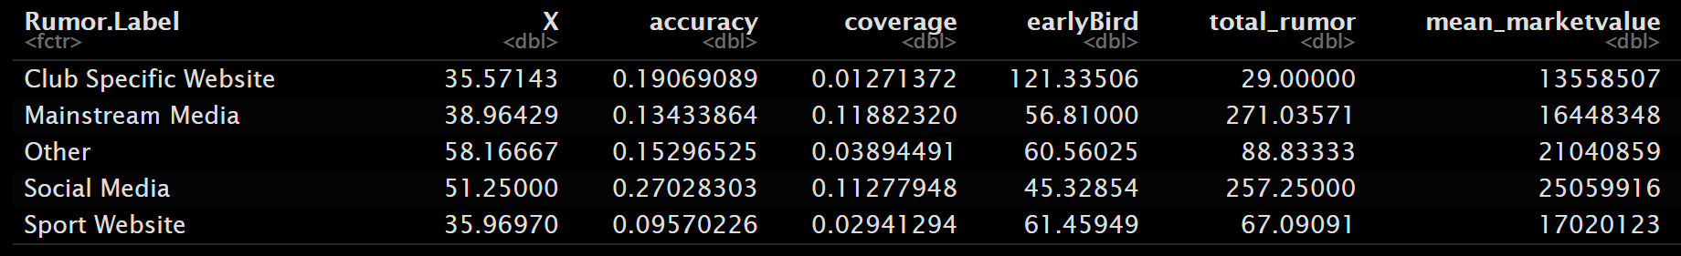
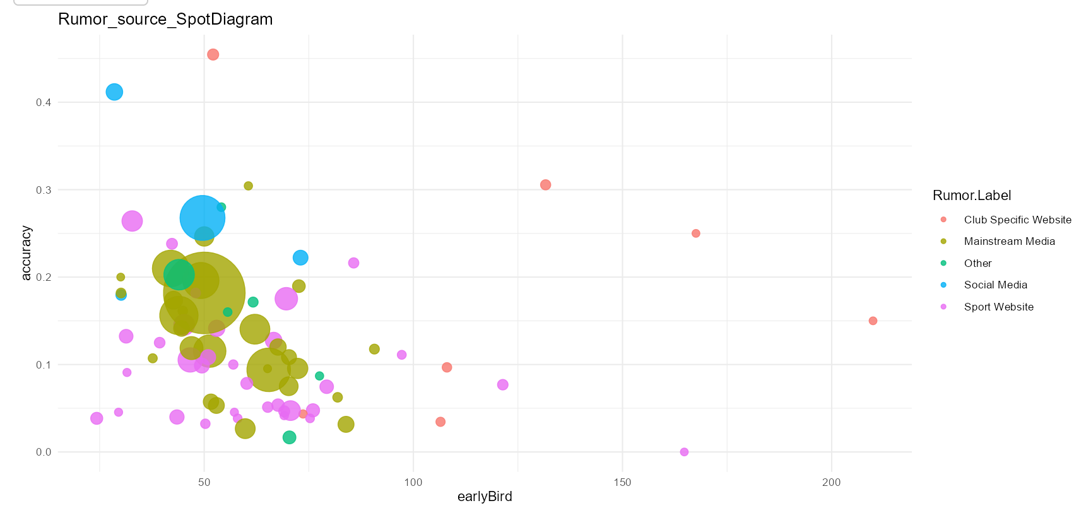
Source-specific Characteristics
Notes:
发现整体earlyBird与accuracy之间存在负相关
Rumor.label组间的accuracy区分度有限，但是earlyBird差别存在

Slide 15
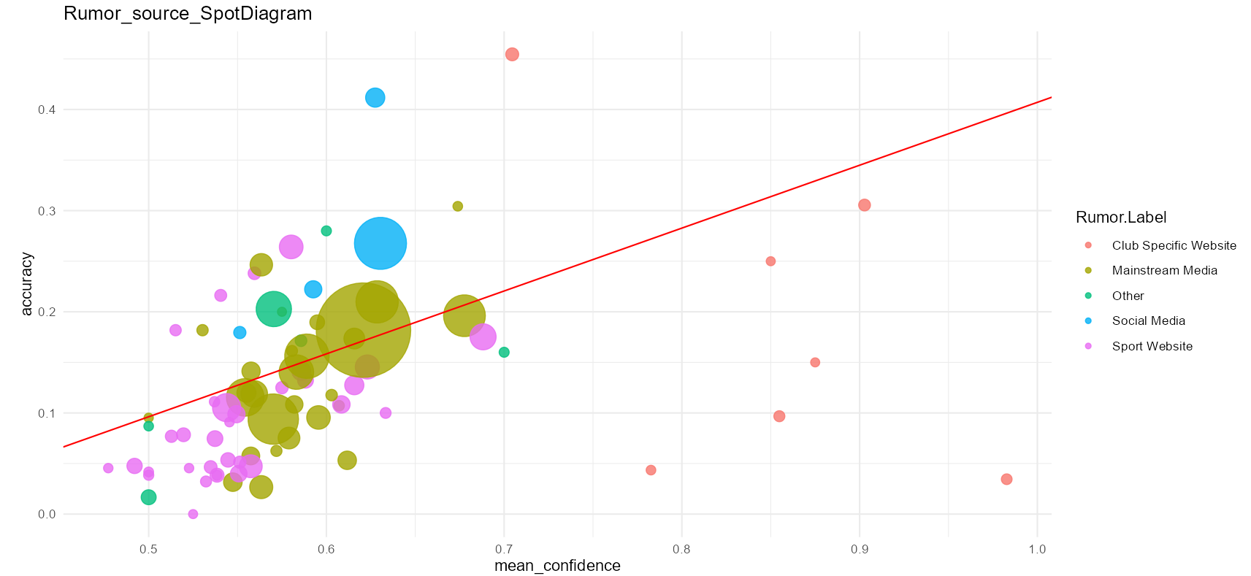
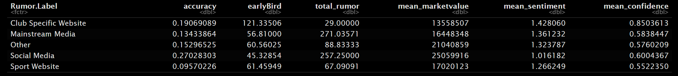
Source-specific Characteristics
Notes:
发现整体GPT.Confidence与accuracy之间存在正相关，且不同source类别之间的mean_confidence存在区别

Slide 16
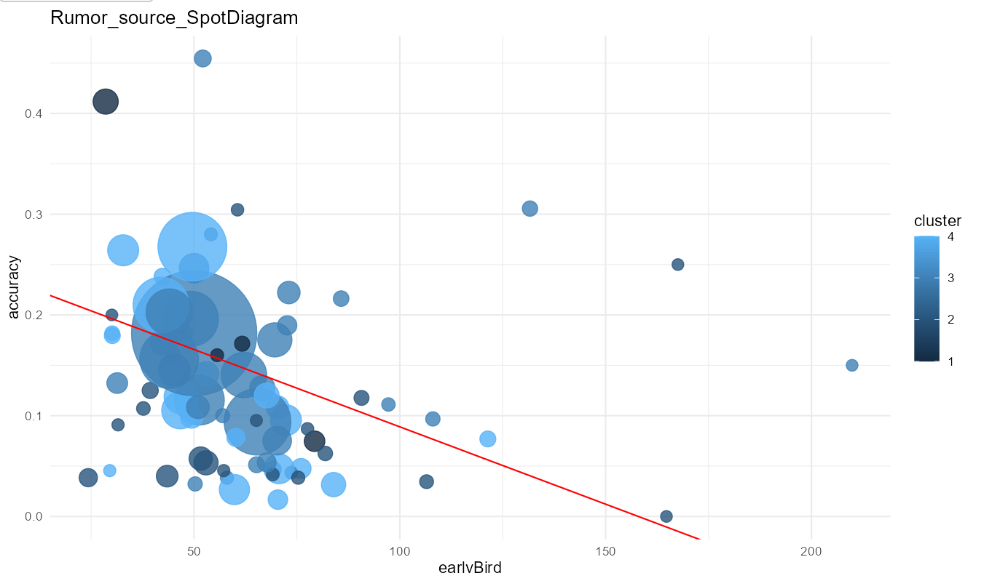
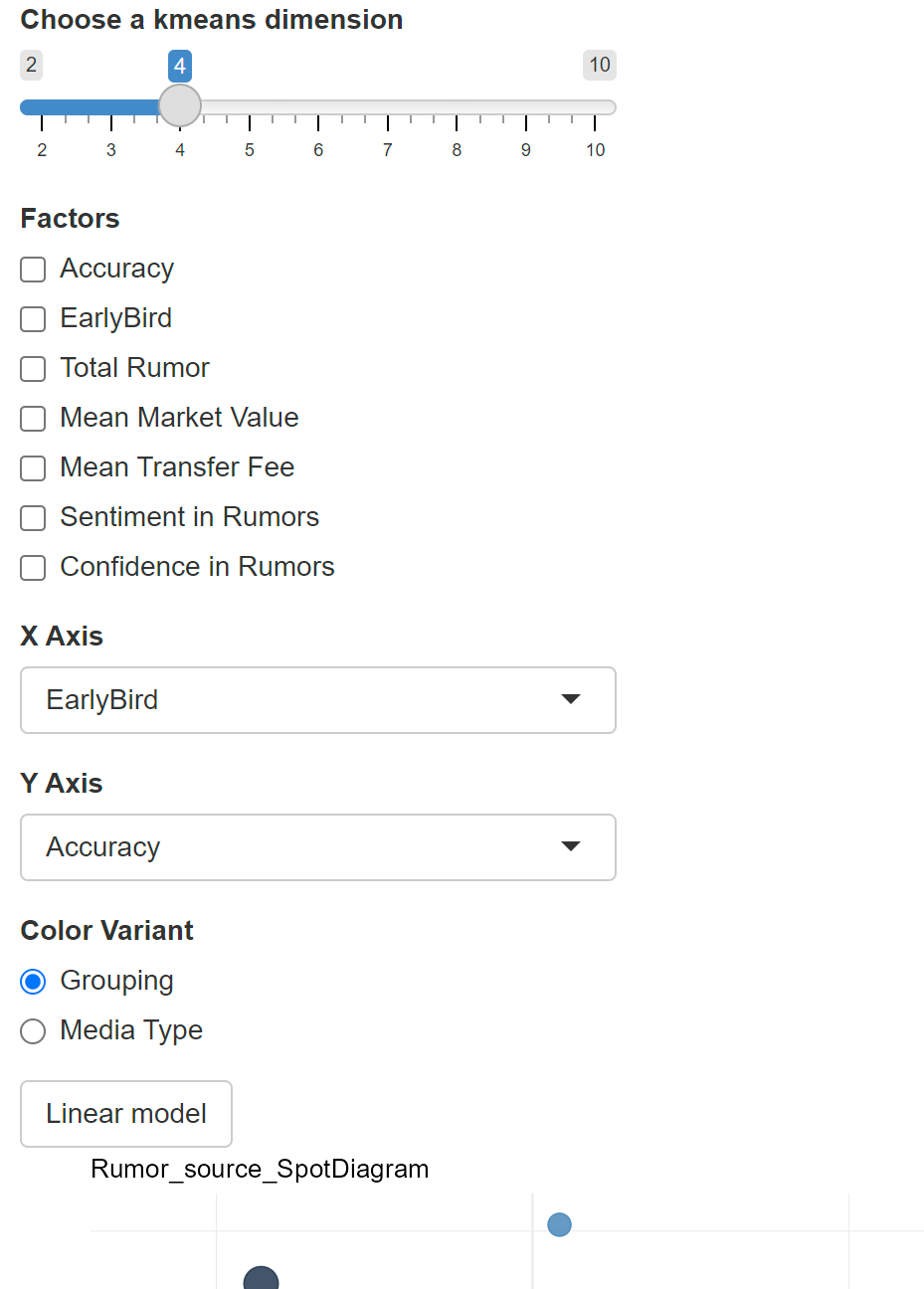
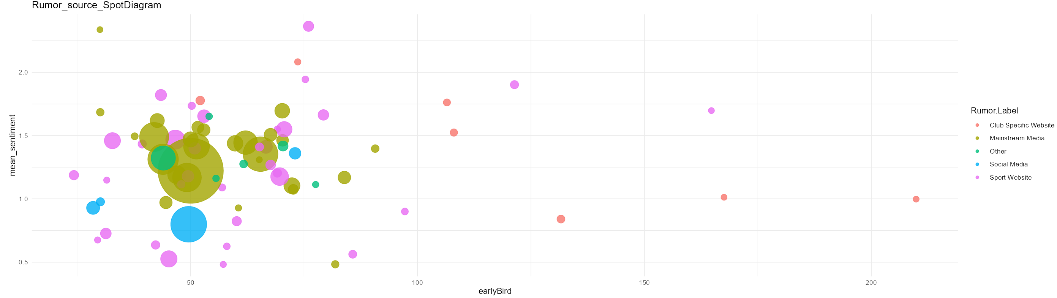
R Shiny
R shiny app developed
User interface:
· kmeans dimension
· x axis, y axis
· color method
· linear model

Slide 17
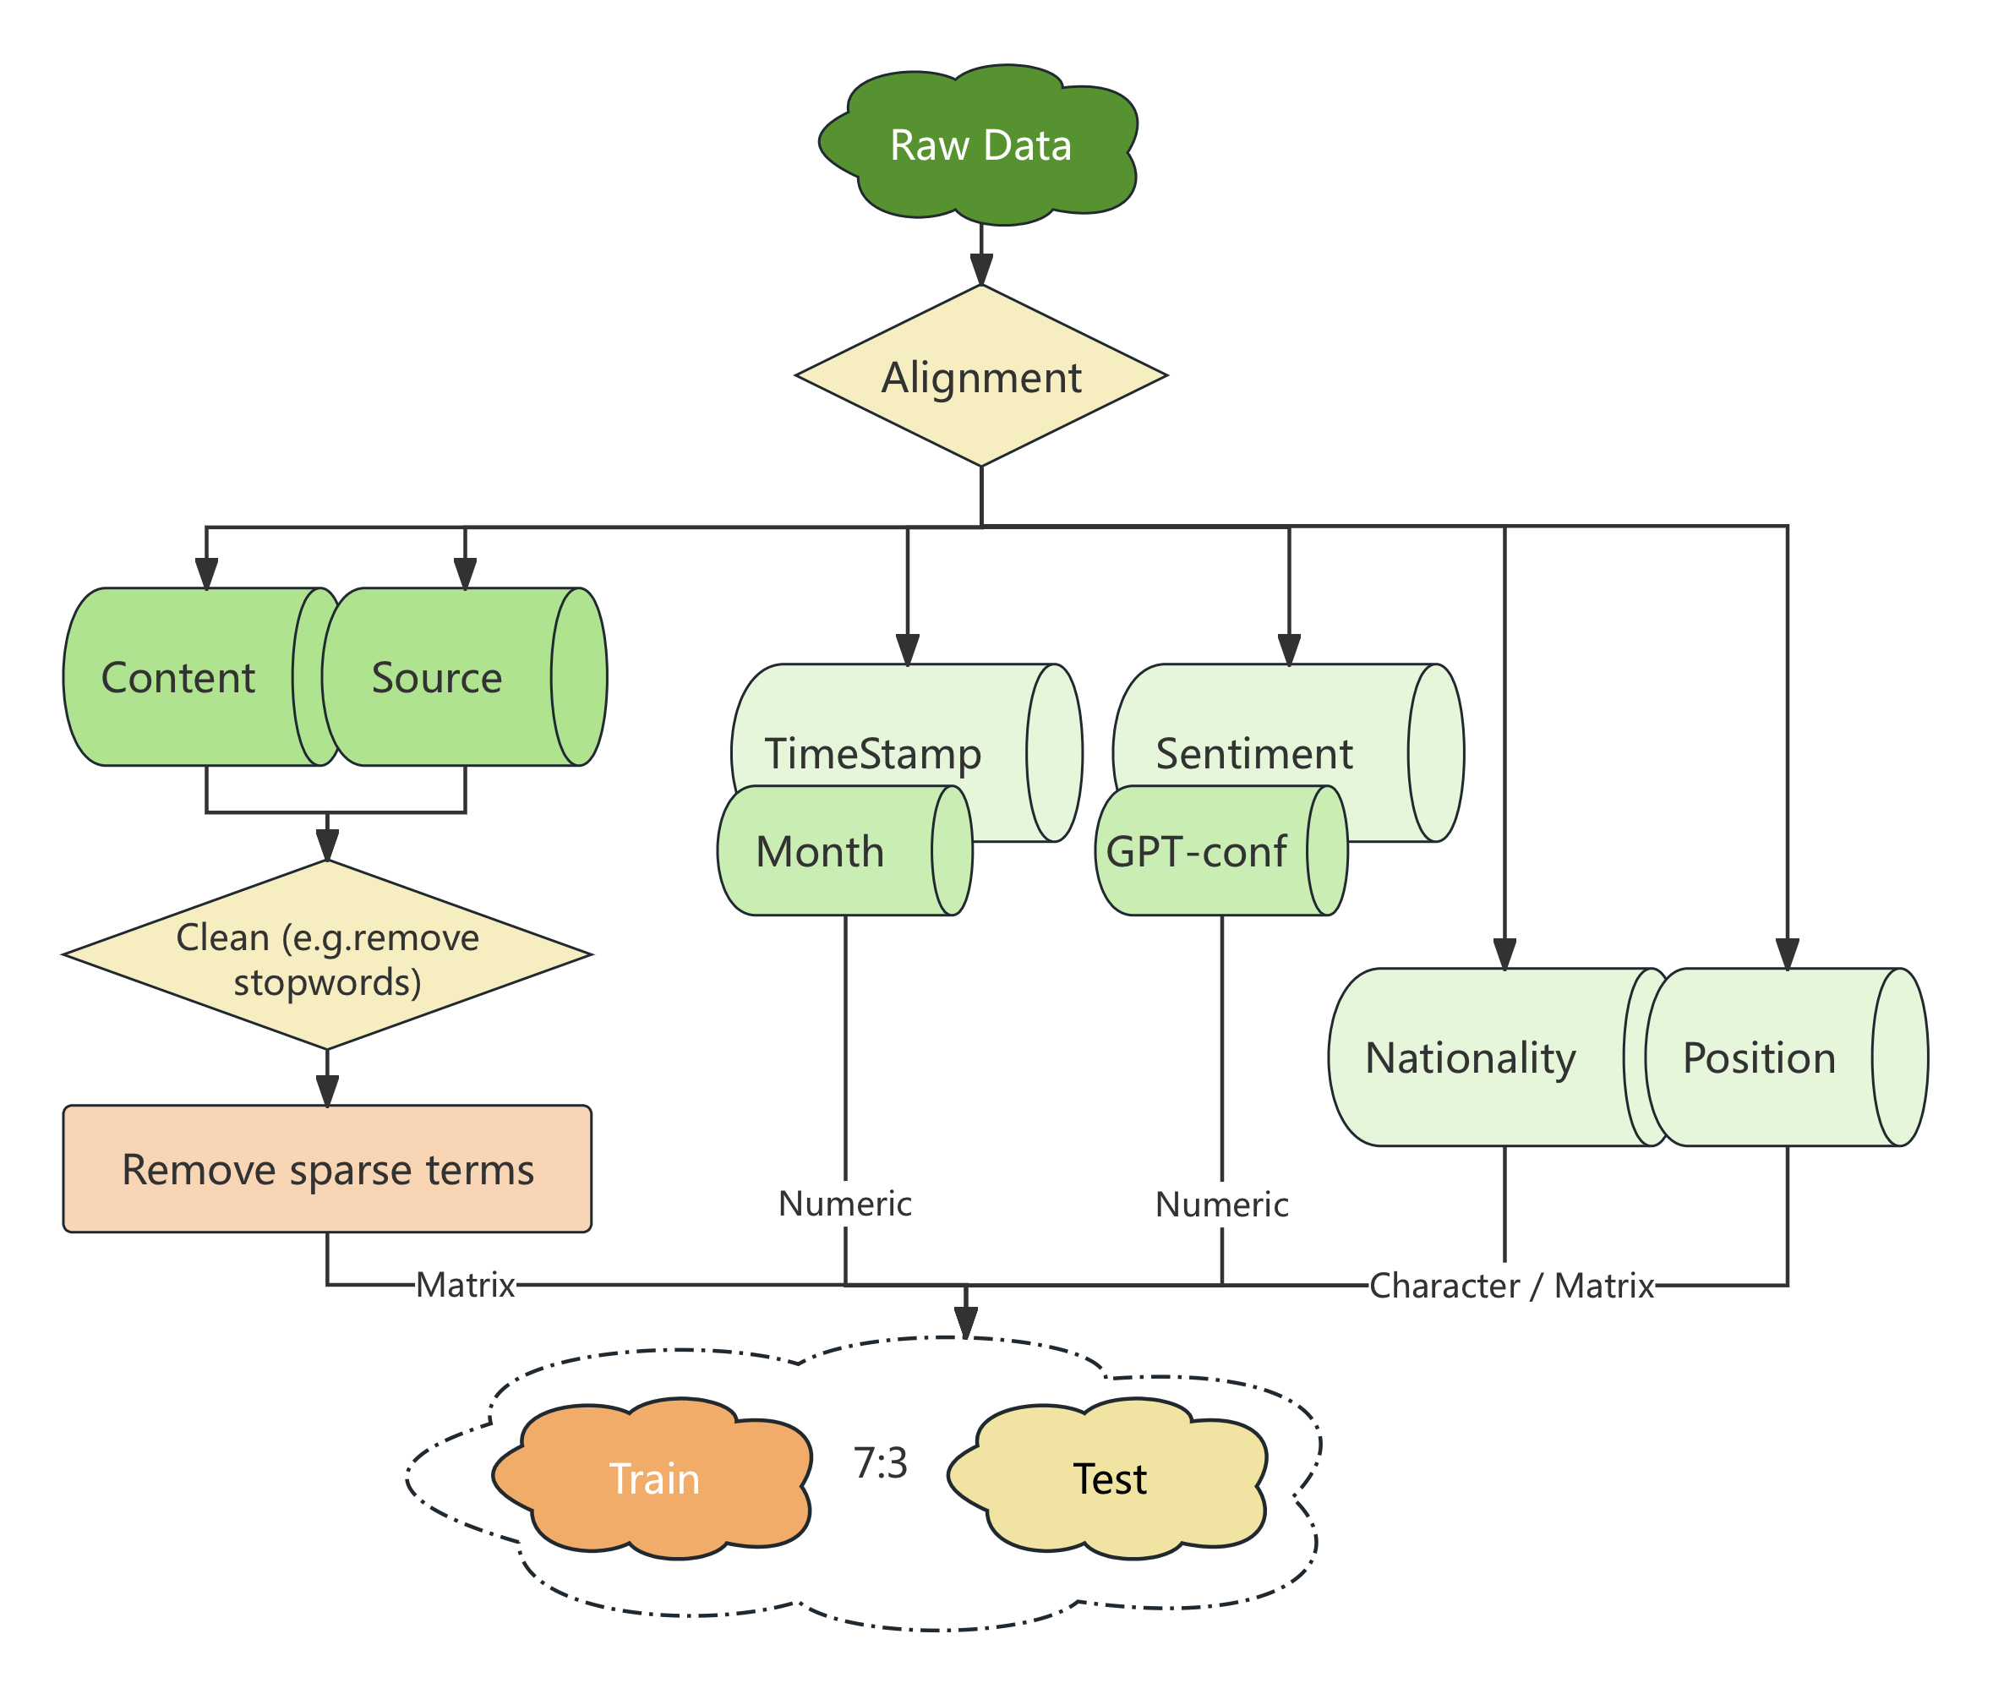
Feature Engineering & Analysis
Pipeline
Notes:
最终建立模型时，时间上选取可解释性较强、特征明显的 month；sentiment 采用 gpt 的 confidence；content 和 source 的特征较复杂，且不排除与其他特征有交叉，因此不特别筛选，采用 0.99 的稀疏度以加快训练；此外，实验表明国籍（Nationality）和角色信息（Position）也有助于预测。 训练测试比 7：3

Slide 18
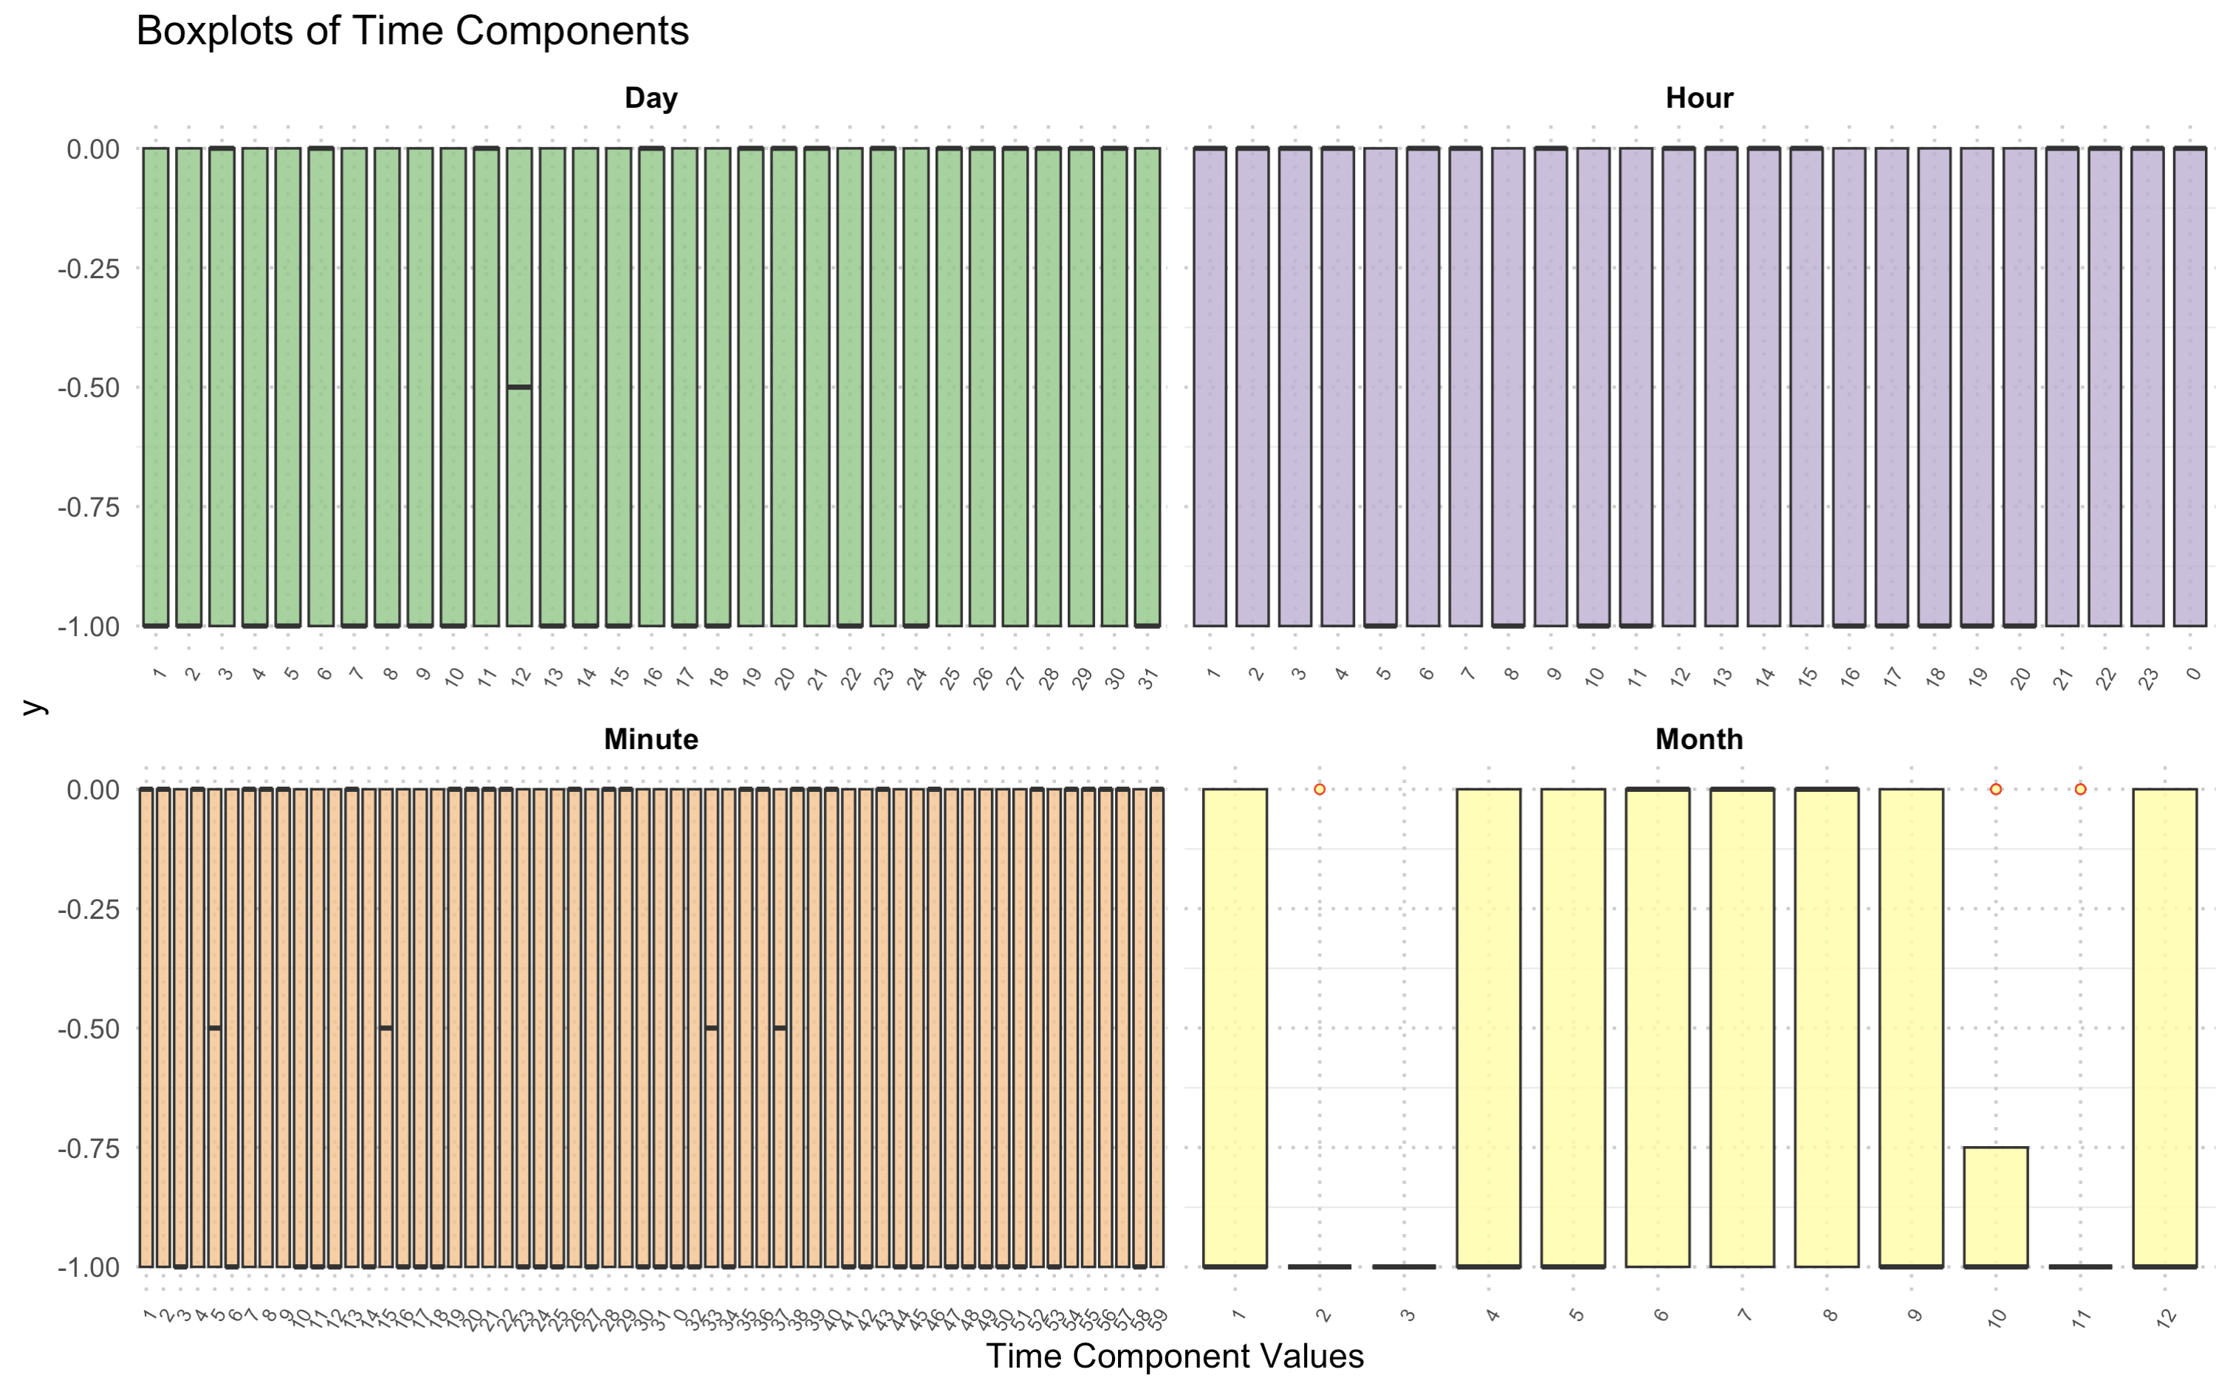
Feature Engineering & Analysis
Time Components - Boxplot

Slide 19
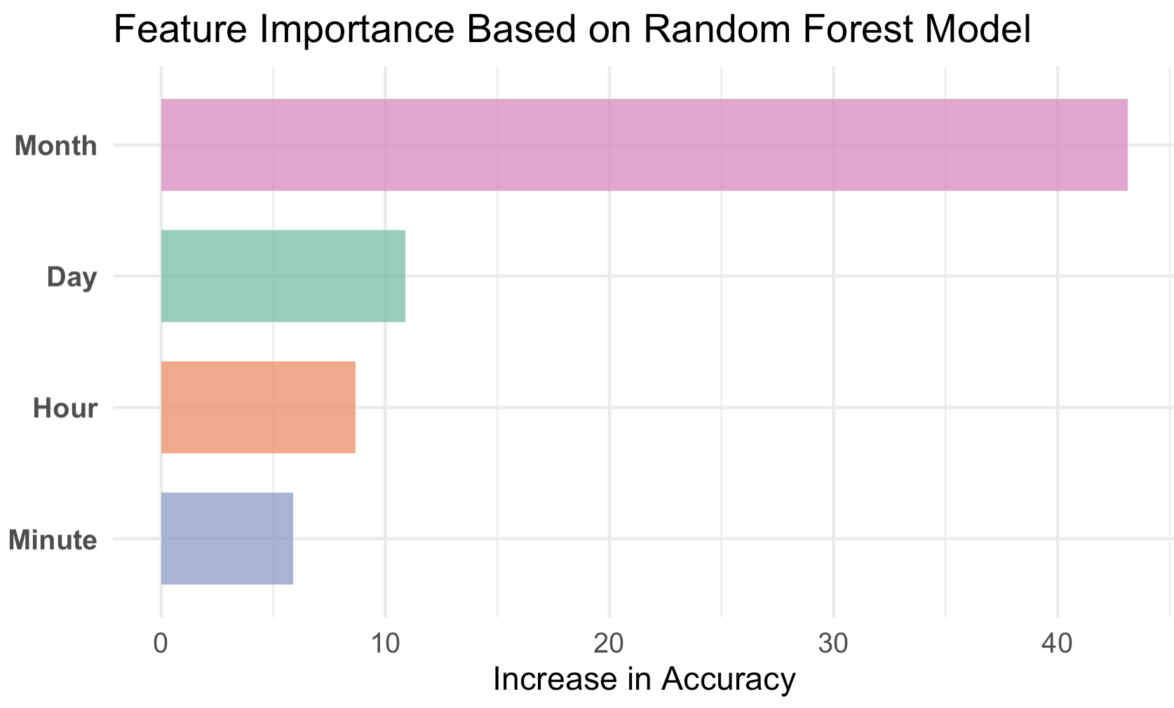
Feature Engineering & Analysis
Time Components - IncAcc using RF model

Slide 20
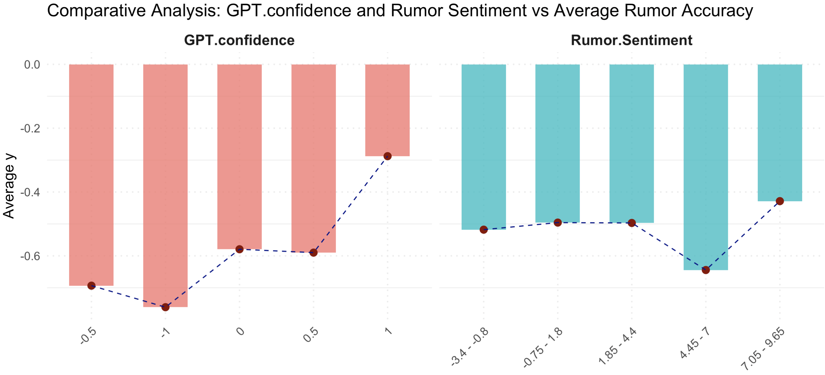
Feature Engineering & Analysis
Sentiments v.s. GPT.Confidence
Variable Correlation
1 GPT.confidence 0.24611174
2 Rumor.Sentiment -0.03115098

Slide 21
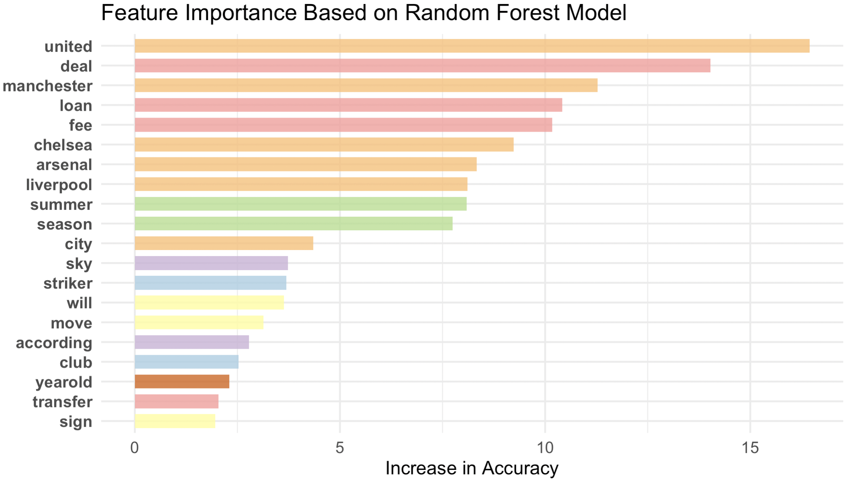
Feature Engineering & Analysis
Rumor Contents - IncAcc using RF model
Clubs
Deals Detail
Time
Source
Players Info
Age
Notes:
united / manchester / chelsea / arsenal / liverpool / city: 这些是足球俱乐部的名字（如曼联、曼城、切尔西、阿森纳等）。它们的出现频率可能与热门球队的新闻更易传播有关。大俱乐部的谣言往往受到更多关注，也更可能被核实，因此它们频繁出现在更真实的新闻中。
deal / transfer / loan / fee: 这些词汇描述了转会操作的核心（交易、转会、租借、转会费等）。谣言中如果包含具体的转会细节，通常更有可信度，因为这表明谣言可能有事实依据。
summer / season: 这些与转会发生的时间有关。转会发生的季节性规律使得提到特定时间（如夏季转会窗口）的谣言更具有可信度。
striker / club: 描述球员的角色或所属的俱乐部。这些词可以帮助判断谣言是否具体和专业，例如谣言涉及具体角色（如前锋）而非泛泛而谈，可信度可能较高。
sky / according: 这些可能是来源相关的词汇，例如“Sky”可能代表新闻来源（Sky Sports），“according”指代谣言引用了信息来源。来源可靠性是评估真实性的重要因素。
sign / move / will: 描述球员动作（签约、转会或意向）。明确行动词通常指向特定的动态，增加可信度。
yearold: 通常指球员的年龄（如“25-year-old”）。提到年龄的谣言更可能有真实依据，因为年龄是转会中常见的讨论点。

Slide 22
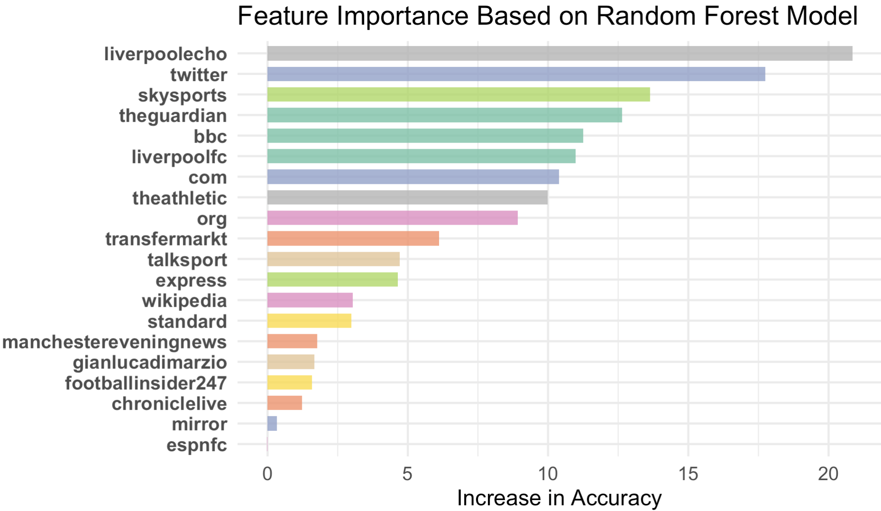
Feature Engineering & Analysis
Rumor Sources- IncAcc using RF model
Notes:
单独用 Source作为预测依据。可能是一些很可靠/很不可靠的媒体，也许可以与之前的 source vs accu 对应上？

Slide 23
Prediction
SVM
ElasticNet
Kernel: radial
Cost: 3
Accuracy: 71.8%
95% CI: (0.6919, 0.7431)
Confusion Matrix:
Reference
Prediction FALSE TRUE
FALSE 429 163
TRUE 181 447
Family: binomial
Lamda: auto; Alpha: 0.5
Accuracy: 73.61%
95% CI : (0.7104, 0.7606)
Confusion Matrix:
Reference
Prediction FALSE TRUE
FALSE 438 150
TRUE 172 460
Notes:
SVM 中，kernal 采用 radial 以捕捉非线性关系、平衡局部和全局。经调整，cost 设置为 3 时训练效果较好。 准确率为 71.8，95% CI : (0.6919, 0.7431)
混淆矩阵：
Reference
Prediction FALSE TRUE
FALSE 429 163
TRUE 181 447
family设置为 binomial，lamda 用 cv.glmnet 自动选择，alpha 手动调参设置为 0.5 准确率为 73.61，95% CI : (0.7104, 0.7606)
混淆矩阵：
Reference
Prediction FALSE TRUE
FALSE 438 150
TRUE 172 460

Slide 24
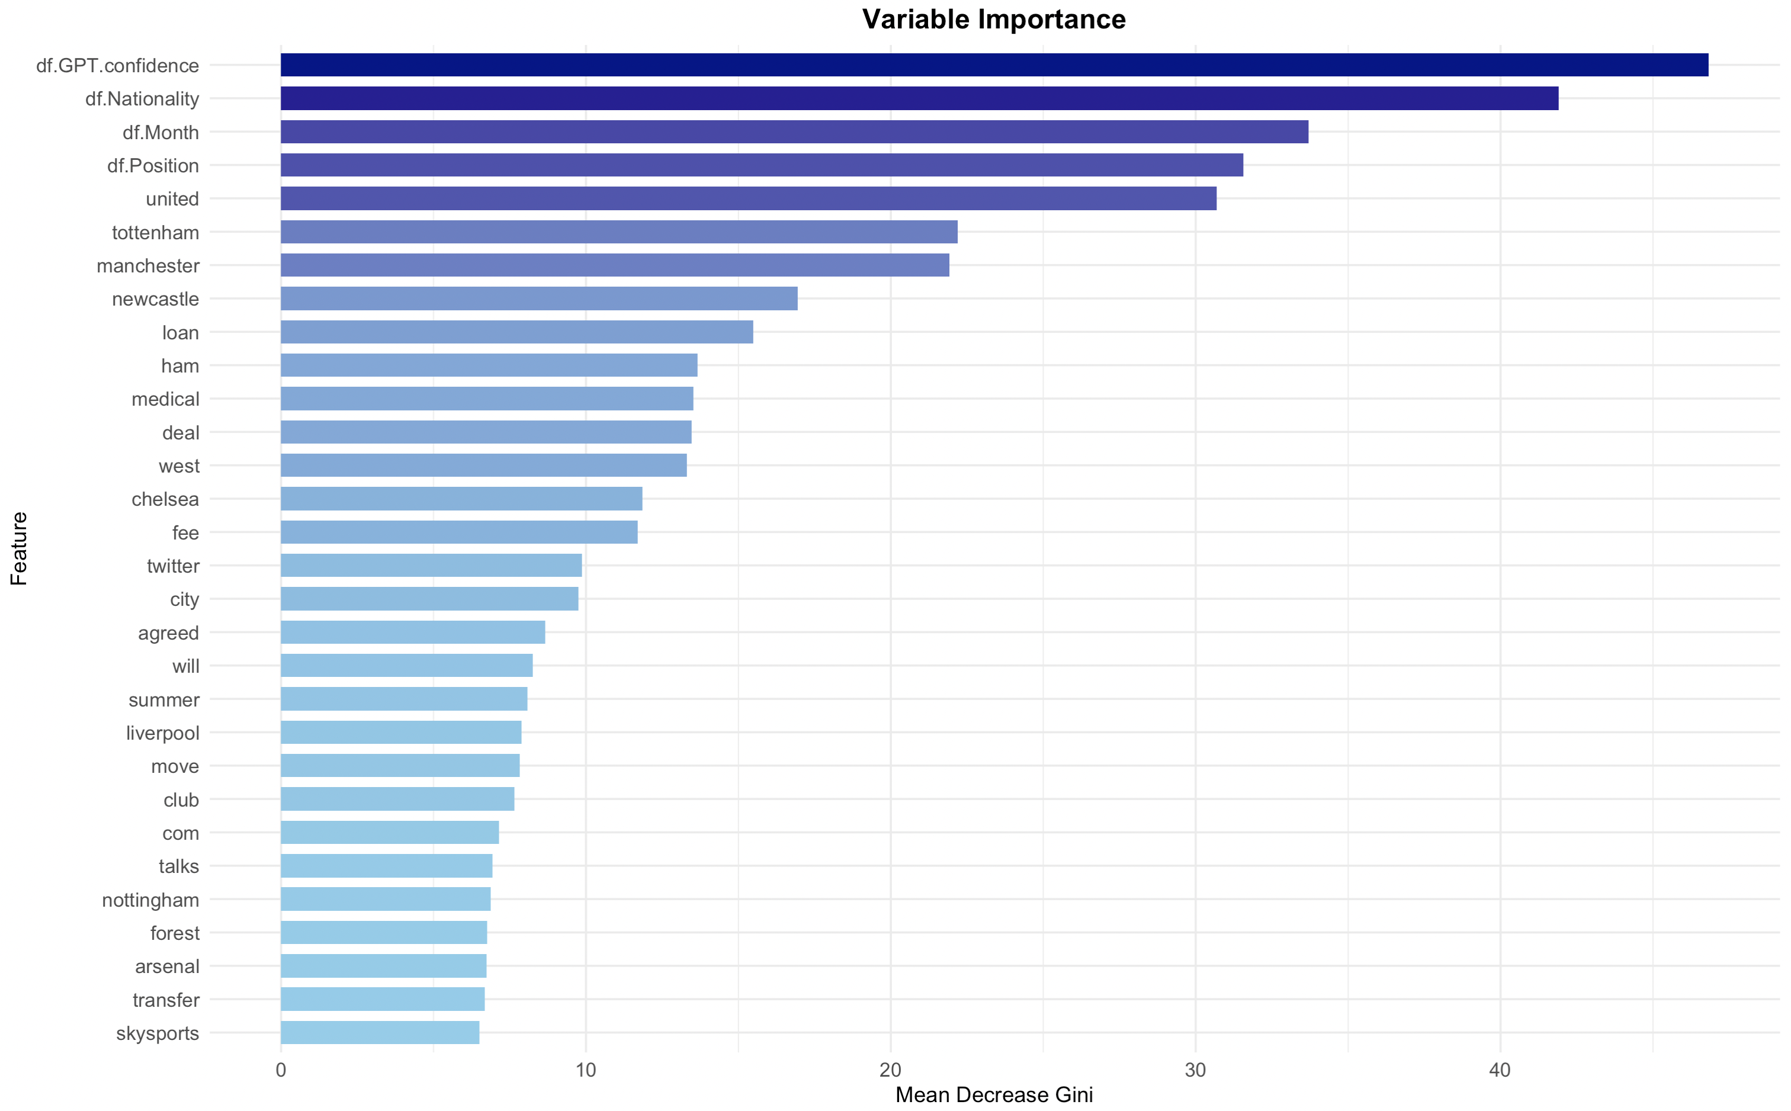
Prediction
Random Forest
Ntree: 300
Accuracy: 73.77%
95% CI: (0.7121, 0.7622)
Confusion Matrix：
Reference
Prediction FALSE TRUE
FALSE 478 188
TRUE 132 422
Notes:
ntree 在 200 时即达到稳定，之后变化不明显。令 ntree=300 准确率为 73.77，95% CI : (0.7121, 0.7622)
混淆矩阵：
Reference
Prediction FALSE TRUE
FALSE 478 188
TRUE 132 422

Slide 25
Discussion
Conclusion
Limitation
We analyzed source characteristics based on clustering.
Our model enables rumor prediction with selected features.
The dataset shows bias in rumor source collection.
There is an imbalance between positive and negative samples, impacting results.

Slide 26
Thanks!
From Rumors to Facts: Evaluating Football Transfer News

